Slide 1
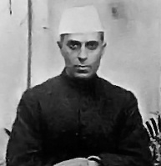
Jawaharlal Nehru – 1st Prime Minister of India
August 15, 1947 – May 27, 1964

Slide 2
Jawaharlal Nehru
Nehru was a Good friend of Gandhi
He also participated in India’s freedom struggle and went to jail for 9 years.
He raised the flag of Independent India on August 15th 1947, when India gained Independence
November 14th is Jawaharlal Nehru’s Birthday and is celebrated as Children’s day (Bal Divas) in India.
Nehru loved children very much.

Slide 3
Nehruji’s Life
He was born Nov. 14, 1889,in Allahabad, India
He was the Son of the independence advocate Motilal Nehru (1861 – 1931),
Nehru was educated at home and in Britain and became a lawyer in 1912. More interested in politics than law, he was impressed by Mohandas K. Gandhi's approach to Indian independence.
His close association with the Indian National Congress began in 1919; in 1929 he became its president, presiding over the historic Lahore session that proclaimed complete independence (rather than dominion status) as India's political goal.
He was imprisoned nine times between 1921 and 1945 for his political activity.
He took office as the Prime Minister of India on 15 August, 1947 and delivered his inaugural address titled “A Tryst With Destiny”:
"Long years ago we made a tryst with destiny, and now the time comes when we shall redeem our pledge, not wholly or in full measure, but very substantially. At the stroke of the midnight hour, when the world sleeps, India will awake to life and freedom. A moment comes, which comes but rarely in history, when we step out from the old to the new, when an age ends, and when the soul of a nation, long suppressed, finds utterance. It is fitting that at this solemn moment we take the pledge of dedication to the service of India and her people and to the still larger cause of humanity."

Slide 4
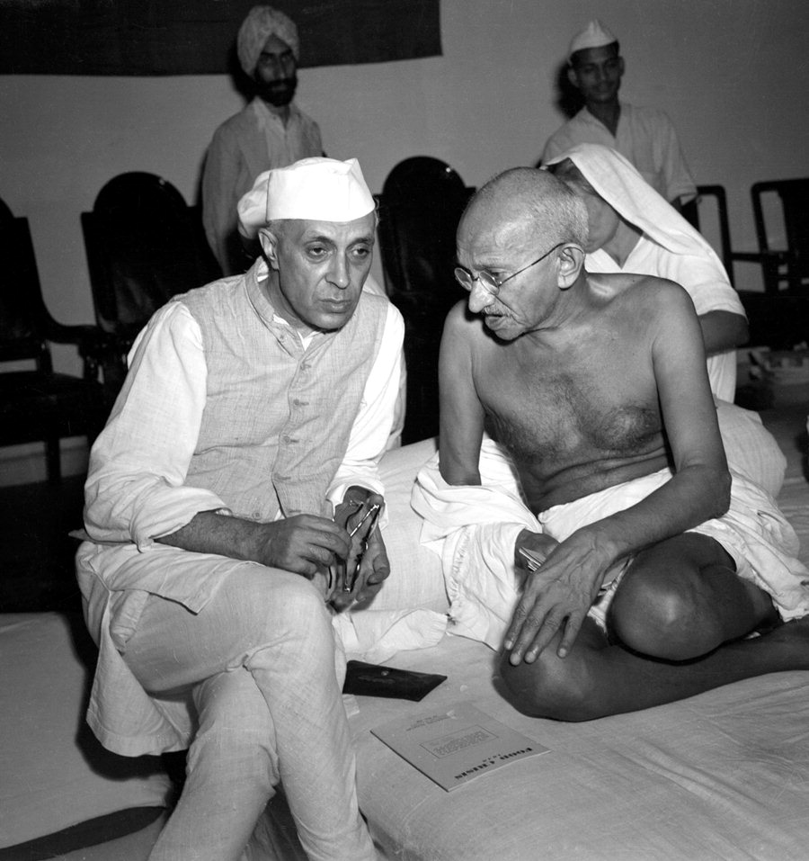
Jawaharlal Nehru with his good friend Mahatma Gandhi

Slide 5
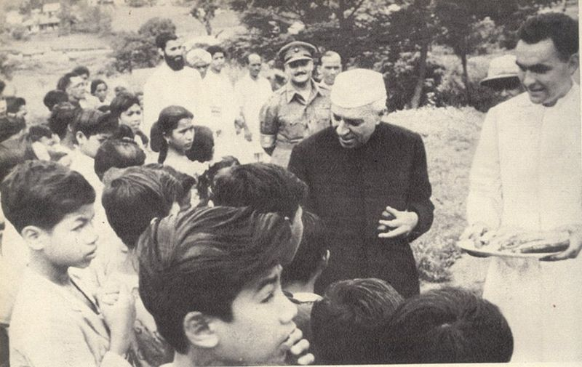
Children’s Day – November 14th for Chacha Nehru
Chacha Nehru loved children

Slide 6
Chacha Nehru’s message to children
Our country is a very big country and there is a great deal to be done by all of us. If each one of us does his or her little bit, then all this mounts up and the country prospers and goes ahead fast.
Children are the future of the nation and the citizens of tomorrow. Children are the real strength of a country and the very foundation of society.

Slide 7
How do we celebrate Children’s Day
Schools celebrate this day by organizing cultural programmes.
Various competitions like quizzes, fancy dress competitions, elocutions are organized on this day.

Slide 8
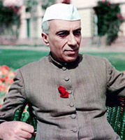
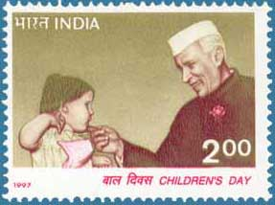
Nehru Loved Rose
Jawaharlal Nehru great love for roses as well as children is a well-known fact. In fact he often compared the two, saying that children were like the buds in a garden. They should be carefully and lovingly nurtured.

Slide 9
Famous Books of Jawaharlal Nehru
He wrote famous books, 'Glimpses of World History' and 'Discovery of India'.
Nehru also wrote many letters to his daughter “Indira Gandhi” (Third Prime minister of India), when he was imprisoned by the British.

